Slide 1

Introduction to Scientific Computing
ENGR1050 – Lecture 1
Fall 2025
Nat Trask
University of Pennsylvania

Slide 2
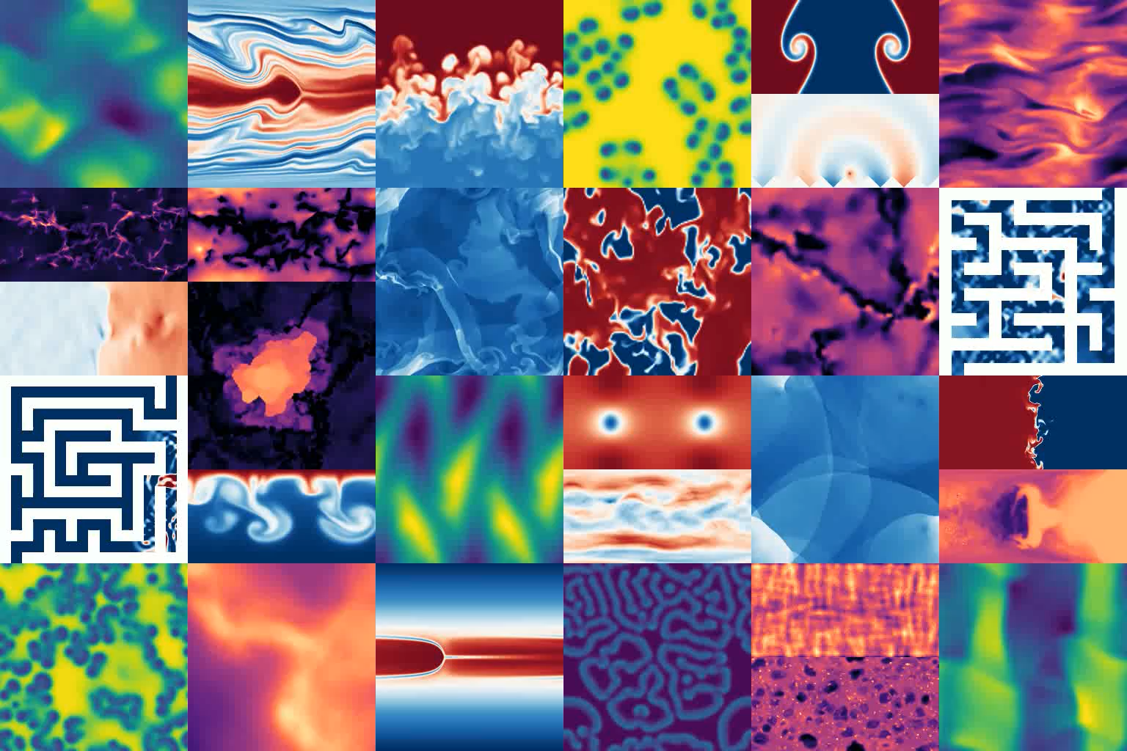
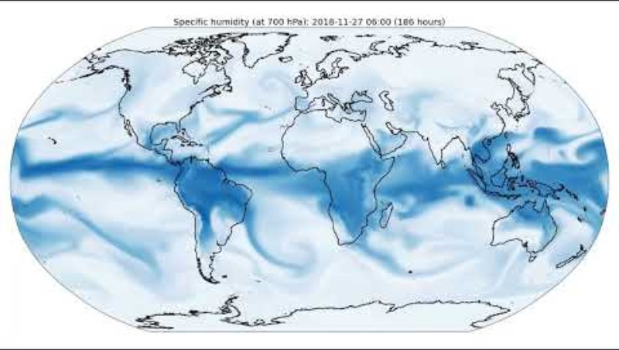
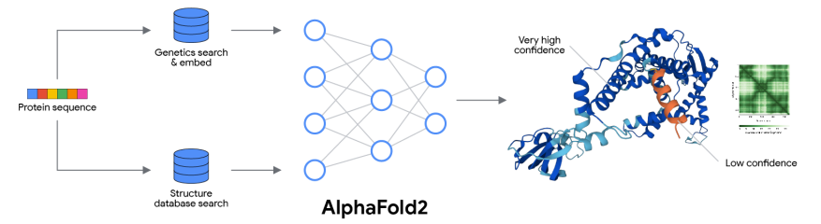



Autoregressive models in state of the art AI4Science
Dominant strategy: Physics-agnostic next token prediction of field data
Goal:
Construct a physics+geometry-based framework to guarantee
Physics + Uniform Stability

Slide 3
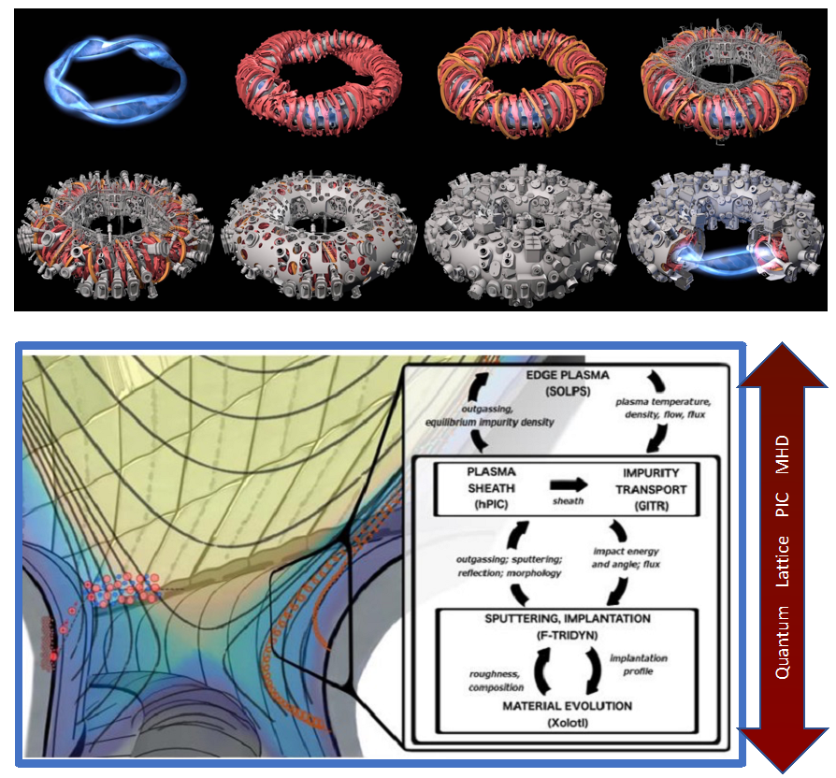
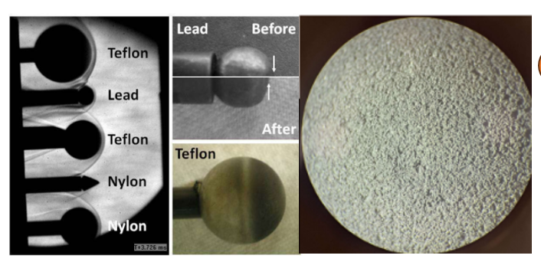
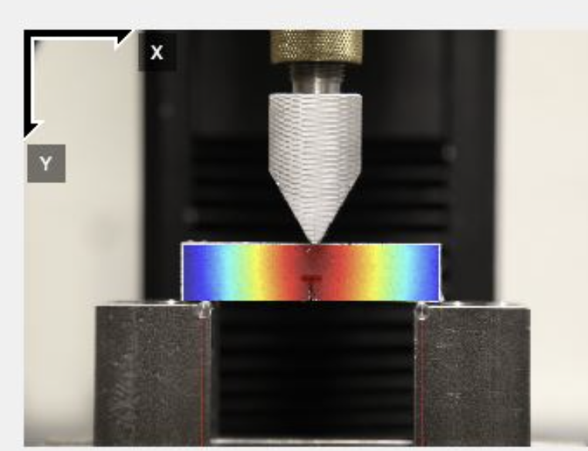
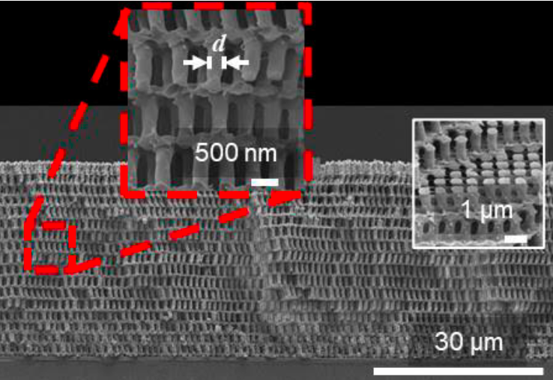
Digital twins direct from experiments: structure preservation requirements
Fusion reactor optimization
Commercialization of complex geometry reactor designs
Need exact handoff of conserved fluxes, Hugoniot relations,
Gauge symmetries
Hypersonic metamaterial design
Treat non-equilibrium physics in multiscale extreme physics processes
Need exact mass transfer, non-equilibrium chemistry, fluctuation/dissipation balance
Data-driven fracture
Homogenized mechanics for multiscale materials from experimental DIC
Exactly balance strain, Griffiths fracture energy for rare events conditioned on mesoscale geometry

Slide 4

Tool 1
Whitney forms
Tool 2
Hybridizable domain decomposition
Tool 3
Conditional neural operators through cross-attention transformers
Model Class 1
Nonlinear boundary value problems
Model Class 2
Uniformly stable autoregressive dynamics

Slide 5
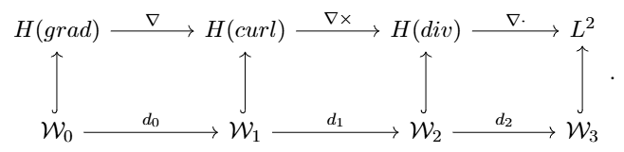
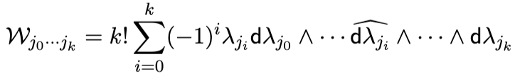
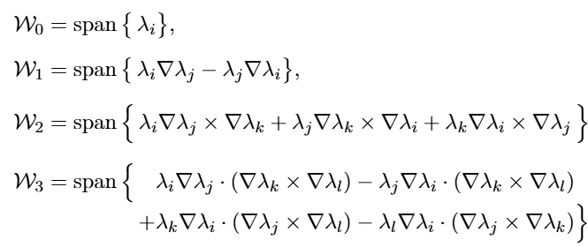
Tool one: Whitney forms
A tool for building finite element spaces that preserve div/grad/curl
Preserves “cohomology”, or simply the div*curl=curl*grad=0 identities
Come from an abstract formula
Start with a partition of unity (e.g. P1 finite elements)
Generate new families of finite elements just by taking derivatives and cross products Good news for autodiff

